Slide 1
Computer Organization

Slide 2
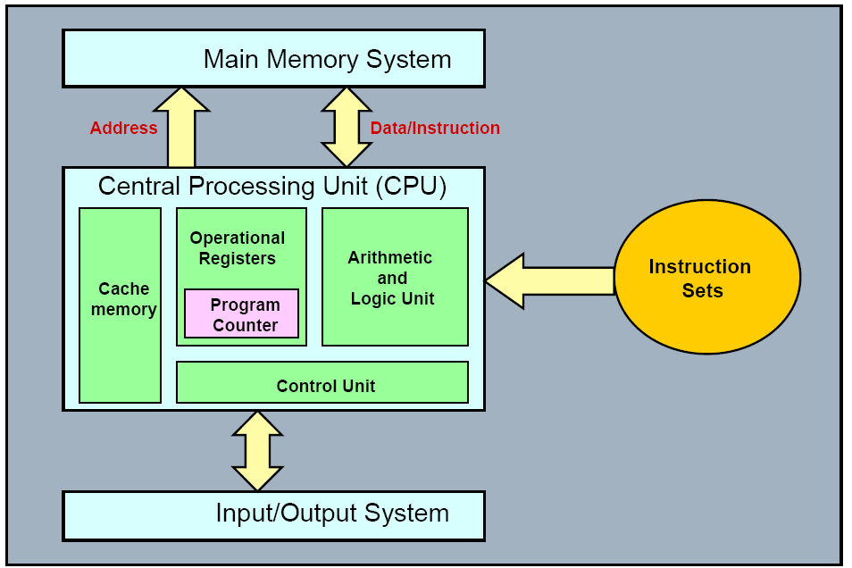
Content Coverage

Slide 3
What is a computer?
a computer is a sophisticated electronic calculating machine that:
  Accepts input information,
  Processes the information according to a list of internally stored instructions and
  Produces the resulting output information.
Functions performed by a computer are:
  Accepting information to be processed as input.
  Storing a list of instructions to process the information.
  Processing the information according to the list of instructions.
  Providing the results of the processing as output.
What are the functional units of a computer?

Slide 4
Functional units of a computer
Input unit accepts
information:
Human operators,
Electromechanical devices (keyboard)
Other computers
Arithmetic and logic unit(ALU):
Performs the desired
operations on the input
information as determined
by instructions in the memory
Memory
Arithmetic
& Logic
Input
Instr1
Instr2
Instr3
Data1
Data2
Output
Control
I/O
Stores
information:
Instructions,
Data
Processor
Control unit coordinates
various actions
Input,
Output
Processing
Output unit sends
results of processing:
To a monitor display,
To a printer

Slide 5
Information in a computer -- Instructions
Instructions specify commands to:
  Transfer information within a computer (e.g., from memory to ALU)
  Transfer of information between the computer and I/O devices (e.g., from keyboard to computer, or computer to printer)
  Perform arithmetic and logic operations (e.g., Add two numbers, Perform a logical AND).
A sequence of instructions to perform a task is called a program, which is stored in the memory.
Processor fetches instructions that make up a program from the memory and performs the operations stated in those instructions.
What do the instructions operate upon?

Slide 6
Information in a computer -- Data
Data are the “operands” upon which instructions operate.
Data could be:
  Numbers,
  Encoded characters.
Data, in a broad sense means any digital information.
Computers use data that is encoded as a string of binary digits called bits.

Slide 7
Input unit
Binary information must be presented to a computer in a specific format. This
task is performed by the input unit:
- Interfaces with input devices.
- Accepts binary information from the input devices.
- Presents this binary information in a format expected by the computer.
- Transfers this information to the memory or processor.
Real world
Computer
Memory
Input Unit
Keyboard
Audio input
……
Processor

Slide 8
Memory unit
Memory unit stores instructions and data.
  Recall, data is represented as a series of bits.
  To store data, memory unit thus stores bits.
Processor reads instructions and reads/writes data from/to the memory during the execution of a program.
  In theory, instructions and data could be fetched one bit at a time.
  In practice, a group of bits is fetched at a time.
  Group of bits stored or retrieved at a time is termed as “word”
  Number of bits in a word is termed as the “word length” of a computer.
In order to read/write to and from memory, a processor should know where to look:
  “Address” is associated with each word location.

Slide 9
Memory unit (contd..)
Processor reads/writes to/from memory based on the memory address:
  Access any word location in a short and fixed amount of time based on the address.
  Random Access Memory (RAM) provides fixed access time independent of the location of the word.
  Access time is known as “Memory Access Time”.
Memory and processor have to “communicate” with each other in order to read/write information.
  In order to reduce “communication time”, a small amount of RAM (known as Cache) is tightly coupled with the processor.
Modern computers have three to four levels of RAM units with different speeds and sizes:
  Fastest, smallest known as Cache
  Slowest, largest known as Main memory.
Notes:
Since the instructions and data need to be feteched from the memory in order to perform a task, the time it takes to access and fetch this information will be one factor influencing how fast a given task will complete. In order to increase the speed of performing a task, one way is to reduce the amount of time it takes to fetch the data and the instructions. This time is called as “access time”.
Suppose if we want to fetch the data at memory location with the address 10. In case of sequential access, we have to access locations 1-9, and then access location 10. Clearly, in case of sequential access the access times increase as memory locations with higher access times are accessed. We need some kind of memory which provides fixed and short access time irrespective of the memory location being accessed. That is, it provides random access.
Why is the access time faster for the Cache than it is for primary storage? I haven’t yet discussed how the various units communicate with each other. In a few minutes I will discuss that, and it will become clear.

Slide 10
Memory unit (contd..)
Primary storage of the computer consists of RAM units.
  Fastest, smallest unit is Cache.
  Slowest, largest unit is Main Memory.
Primary storage is insufficient to store large amounts of data and programs.
  Primary storage can be added, but it is expensive.
Store large amounts of data on secondary storage devices:
  Magnetic disks and tapes,
  Optical disks (CD-ROMS).
  Access to the data stored in secondary storage in slower, but take advantage of the fact that some information may be accessed infrequently.
Cost of a memory unit depends on its access time, lesser access time implies higher cost.

Slide 11
Arithmetic and logic unit (ALU)
Operations are executed in the Arithmetic and Logic Unit (ALU).
  Arithmetic operations such as addition, subtraction.
  Logic operations such as comparison of numbers.
In order to execute an instruction, operands need to be brought into the ALU from the memory.
  Operands are stored in general purpose registers available in the ALU.
  Access times of general purpose registers are faster than the cache.
Results of the operations are stored back in the memory or retained in the processor for immediate use.

Slide 12
Output unit
Computers represent information in a specific binary form. Output units:
- Interface with output devices.
- Accept processed results provided by the computer in specific binary form.
- Convert the information in binary form to a form understood by an
output device.
Computer
Real world
Memory
Printer
Graphics display
Speakers
……
Output Unit
Processor

Slide 13
Control unit
Operation of a computer can be summarized as:
  Accepts information from the input units (Input unit).
  Stores the information (Memory).
  Processes the information (ALU).
  Provides processed results through the output units (Output unit).
Operations of Input unit, Memory, ALU and Output unit are coordinated by Control unit.
Instructions control “what” operations take place (e.g. data transfer, processing).
Control unit generates timing signals which determines “when” a particular operation takes place.

Slide 14
How are the functional units connected?
For a computer to achieve its operation, the functional units need to
communicate with each other.
In order to communicate, they need to be connected.
Input
Output
Memory
Processor
Bus
Functional units may be connected by a group of parallel wires.
The group of parallel wires is called a bus.
Each wire in a bus can transfer one bit of information.
The number of parallel wires in a bus is equal to the word length of
a computer
Notes:
What is a word? What is a word length? During the discussion of which functional unit did we come across this concept?

Slide 15
Organization of cache and main memory
Main
Cache
Processor
memory
memory
Bus
Why is the access time of the cache memory lesser than the
access time of the main memory?

Slide 16
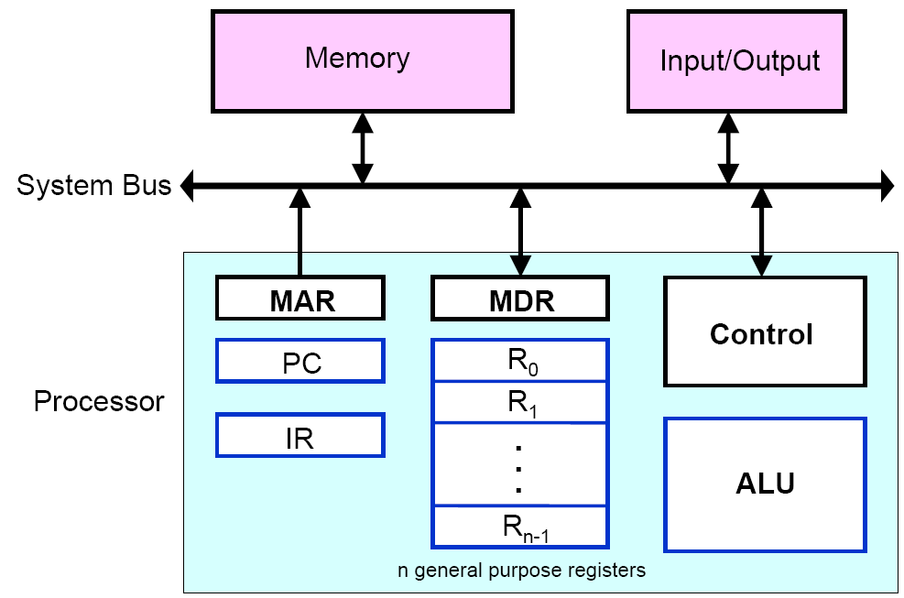
Computer Components: Top-Level View

Slide 17
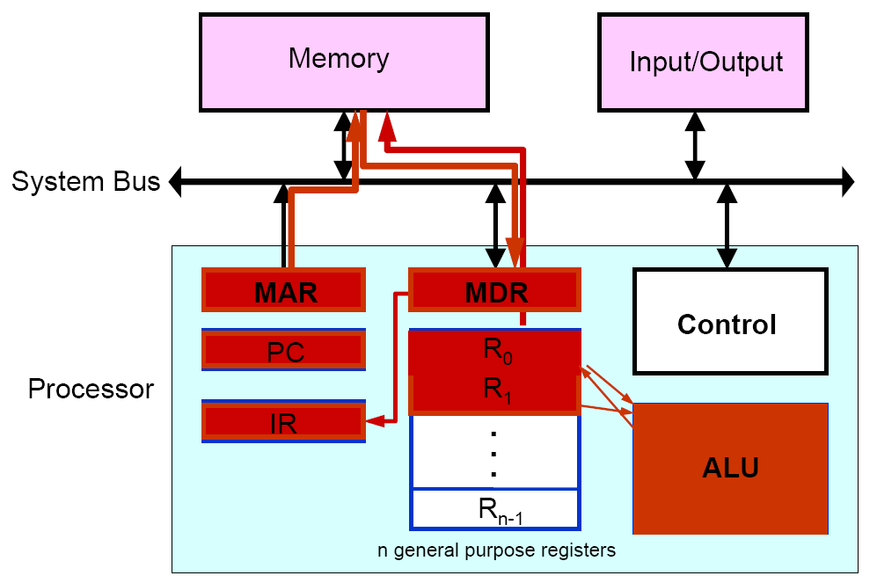
Basic Operational Concepts

Slide 18
Interrupt
Normal execution of programs may be interrupted if some device requires urgent servicing
  To deal with the situation immediately, the normal execution of the current program must be interrupted
Procedure of interrupt operation
  The device raises an interrupt signal
  The processor provides the requested service by executing an appropriate interrupt-service routine
  The state of the processor is first saved before servicing the interrupt
    Normally, the contents of the PC, the general registers, and some control information are stored in memory
  When the interrupt-service routine is completed, the state of the processor is restored so that the interrupted program may continue

Slide 19
Classes of Interrupts
Program
  Generated by some condition that occurs as a result of an instruction execution such as arithmetic overflow, division by zero, attempt to execute an illegal machine instruction, or reference outside a user’s allowed memory space
Timer
  Generated by a timer within the processor. This allows the operating system to perform certain functions on a regular basis
I/O
  Generated by an I/O controller, to signal normal completion of an operation or to signal a variety of error conditions
Hardware failure
  Generated by a failure such as power failure or memory parity error

Slide 20
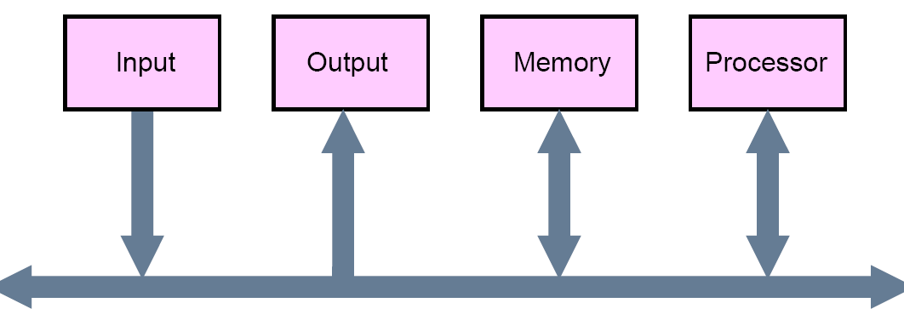
Bus Structures
A group of lines that serves a connecting path for several devices is called a bus
  In addition to the lines that carry the data, the bus must have lines for address and control purposes
  The simplest way to interconnect functional units is to use a single bus, as shown below

Slide 21
Drawbacks of the Single Bus Structure
The devices connected to a bus vary widely in their speed of operation
  Some devices are relatively slow, such as printer and keyboard
  Some devices are considerably fast, such as optical disks
  Memory and processor units operate are the fastest parts of a computer
Efficient transfer mechanism thus is needed to cope with this problem
  A common approach is to include buffer registers with the devices to hold the information during transfers
  An another approach is to use two-bus structure and an additional transfer mechanism
    A high-performance bus, a low-performance, and a bridge for transferring the data between the two buses. ARMA Bus belongs to this structure

Slide 22
Software
In order for a user to enter and run an application program, the computer must already contain some system software in its memory
System software is a collection of programs that are executed as needed to perform functions such as
  Receiving and interpreting user commands
  Running standard application programs such as word processors, etc, or games
  Managing the storage and retrieval of files in secondary storage devices
  Controlling I/O units to receive input information and produce output results

Slide 23
Software
Translating programs from source form prepared by the user into object form consisting of machine instructions
Linking and running user-written application programs with existing standard library routines, such as numerical computation packages
System software is thus responsible for the coordination of all activities in a computing system

Slide 24
Operating System
Operating system (OS)
  This is a large program, or actually a collection of routines, that is used to control the sharing of and interaction among various computer units as they perform application programs
The OS routines perform the tasks required to assign computer resource to individual application programs
  These tasks include assigning memory and magnetic disk space to program and data files, moving data between memory and disk units, and handling I/O operations
In the following, a system with one processor, one disk, and one printer is given to explain the basics of OS
  Assume that part of the program’s task involves reading a data file from the disk into the memory, performing some computation on the data, and printing the results

Slide 25
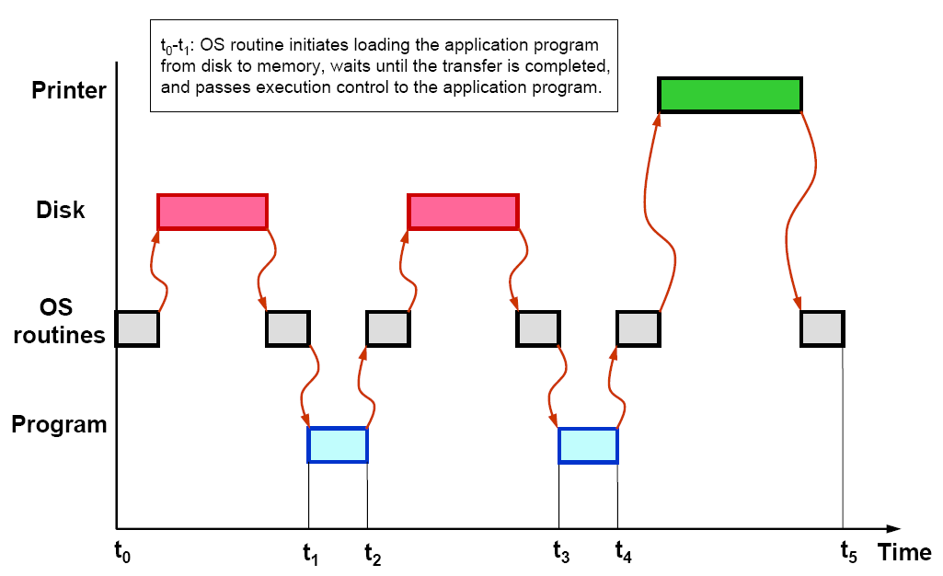
User Program and OS Routine Sharing

Slide 26
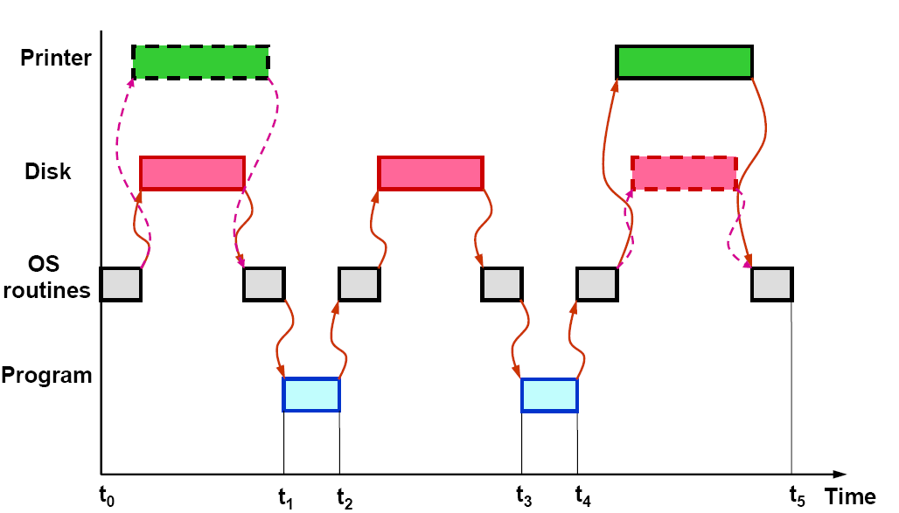
Multiprogramming or Multitasking

Slide 27
Performance
The speed with which a computer executes programs is affected by the design of its hardware and its machine language instructions
Because programs are usually written in a high-level language, performance is also affected by the compiler that translates programs into machine languages
For best performance, the following factors must be considered
  Compiler
  Instruction set
  Hardware design

Slide 28
Performance
Processor circuits are controlled by a timing signal called a clock
  The clock defines regular time intervals, called clock cycles
To execute a machine instruction, the processor divides the action to be performed into a sequence of basic steps, such that each step can be completed in one clock cycle
Let the length P of one clock cycle, its inverse is the clock rate, R=1/P
Basic performance equation
  T=(NxS)/R, where T is the processor time required to execute a program, N is the number of instruction executions, and S is the average number of basic steps needed to execute one machine instruction

Slide 29
Performance Improvement
Pipelining and superscalar operation
  Pipelining: by overlapping the execution of successive instructions
  Superscalar: different instructions are concurrently executed with multiple instruction pipelines. This means that multiple functional units are needed
Clock rate improvement
Improving the integrated-circuit technology makes logic circuits faster, which reduces the time needed to complete a basic step

Slide 30
Performance Improvement
Reducing amount of processing done in one basic step also makes it possible to reduce the clock period, P.
However, if the actions that have to be performed by an instruction remain the same, the number of basic steps needed may increase
Reduce the number of basic steps to execute
  Reduced instruction set computers (RISC) and complex instruction set computers (CISC)

